Slide 1
Red Temática Española de Open Data y Smart Cities
ARC Engineering and Architecture La Salle:
ENERGY INFORMATION SYSTEMS for DECISION MAKING
Álvaro Sicilia
ARC Engineering and Architecture La Salle
Ramon Llull University, Barcelona, Spain
www.salleurl.edu/arc

Slide 2
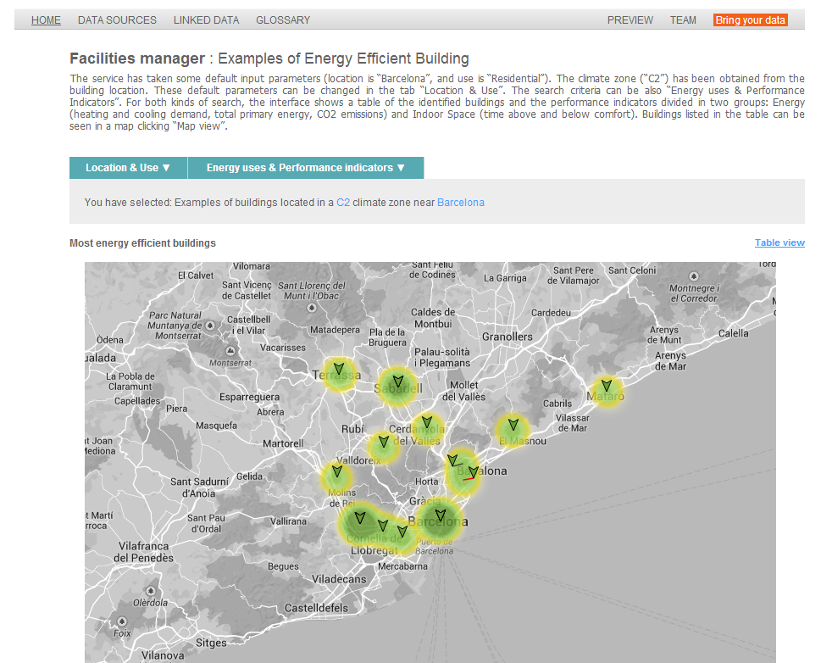
Notes:
Integration of data from multiple sources using Semantic Web technologies
Taxonomy of energy related data
Ontology representing a building energy model
On-line application focused on specific user profiles
We have devised and implemented a methodology to create a semantic-based energy information system with the objective of interlinking multiple sources of data along the different stages of the building life cycle. The design of the system starts with the analysis of the current needs about energy information at the specific stages of the building life cycle and continues with the modelling of the interactions between users, data and the activities by means of use cases. Use cases encapsulate the specification requirements and the underlying energy model. The energy model is later formalized as an ontology that can be defined as a formal shared vocabulary that facilitates data access to users from different domains, operating at different phases of the building life cycle.

Slide 3
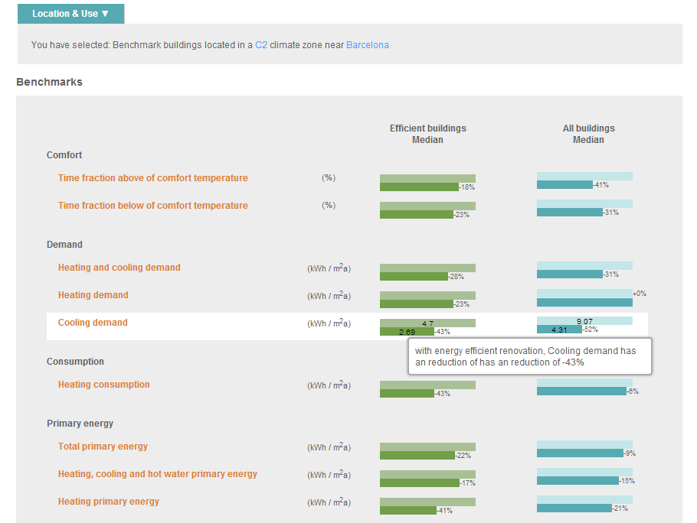

Slide 4
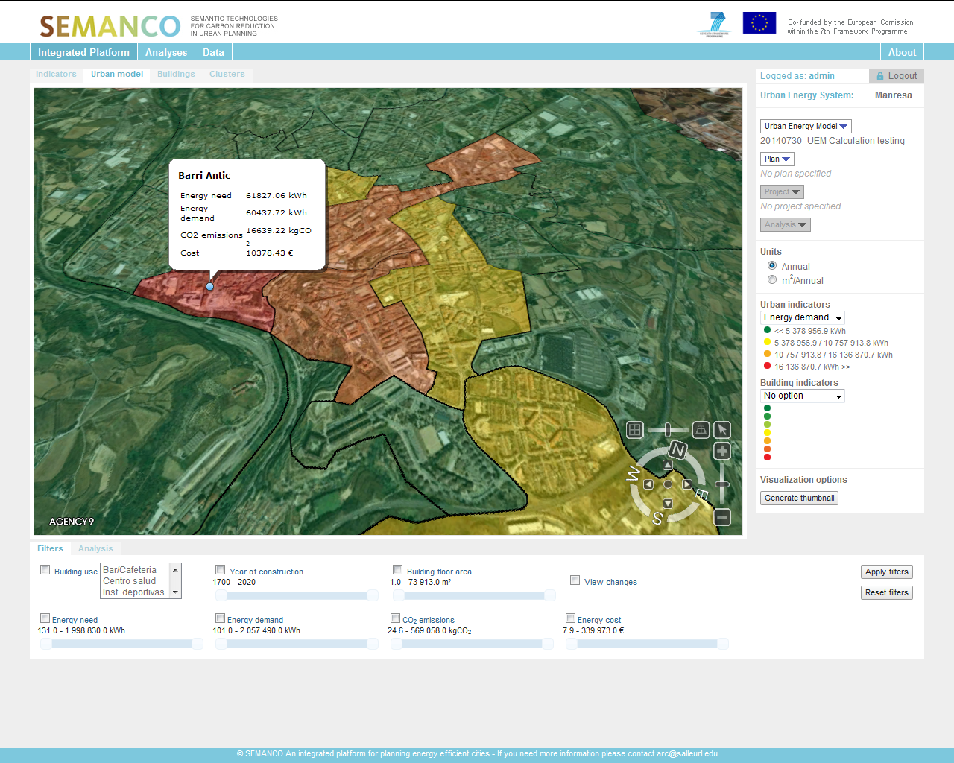
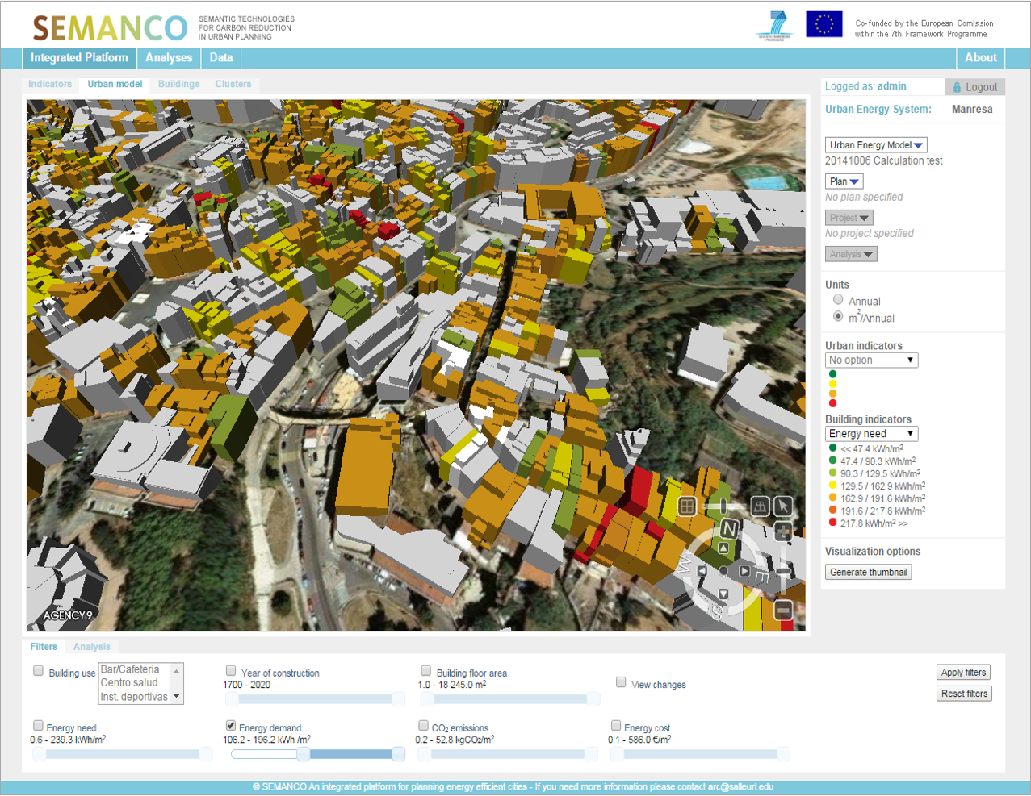
EECITIES is a provider of energy analysis services to support the planning of energy efficient cities.
The services are based on the technologies developed in the SEMANCO project co-funded by the 7th Framework Programme 2011-14.

Slide 5
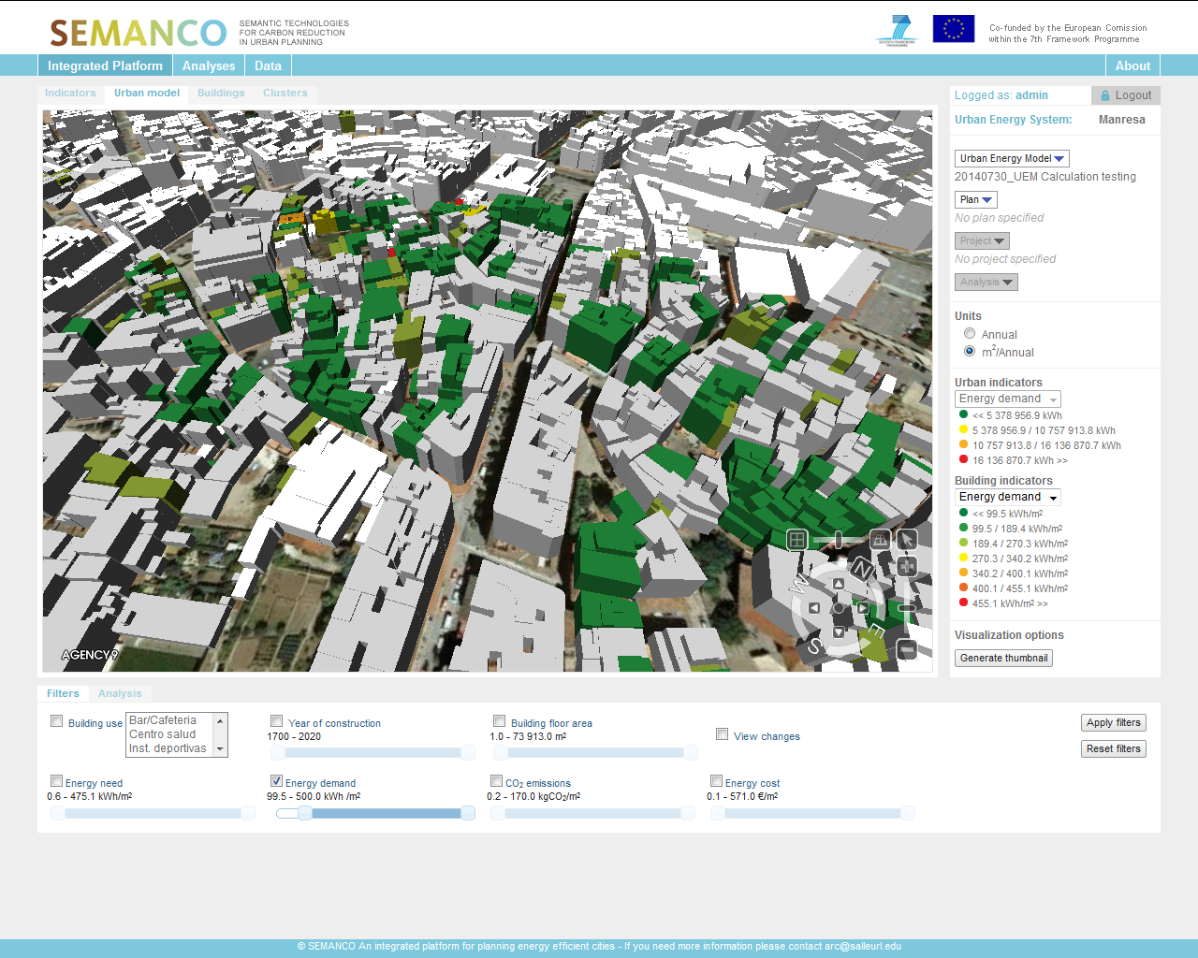
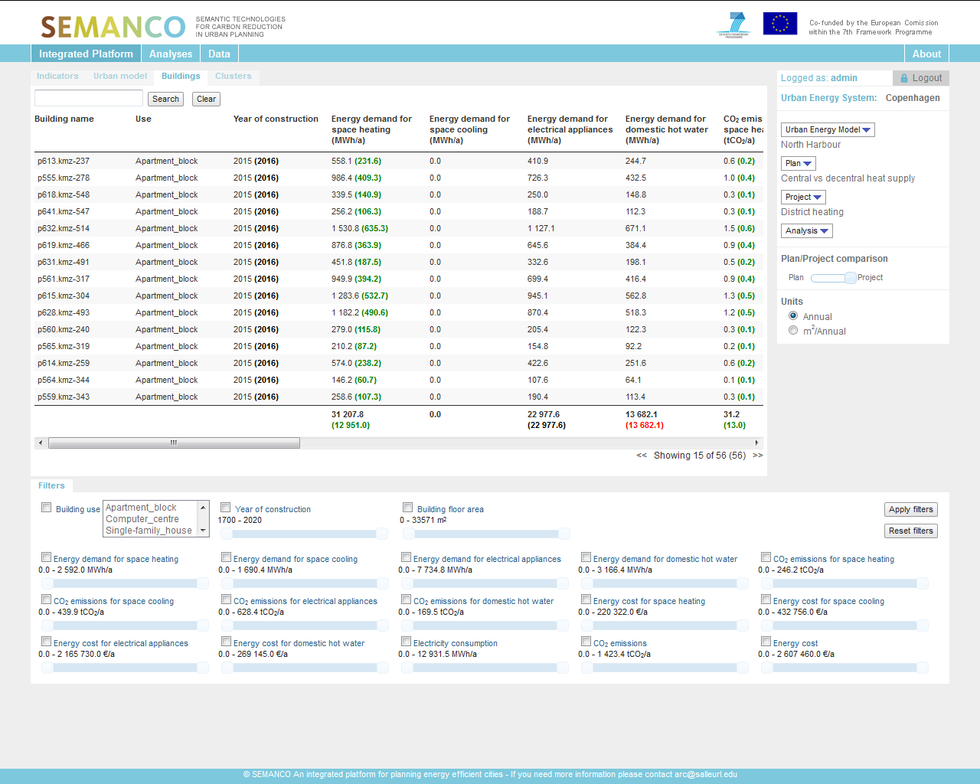
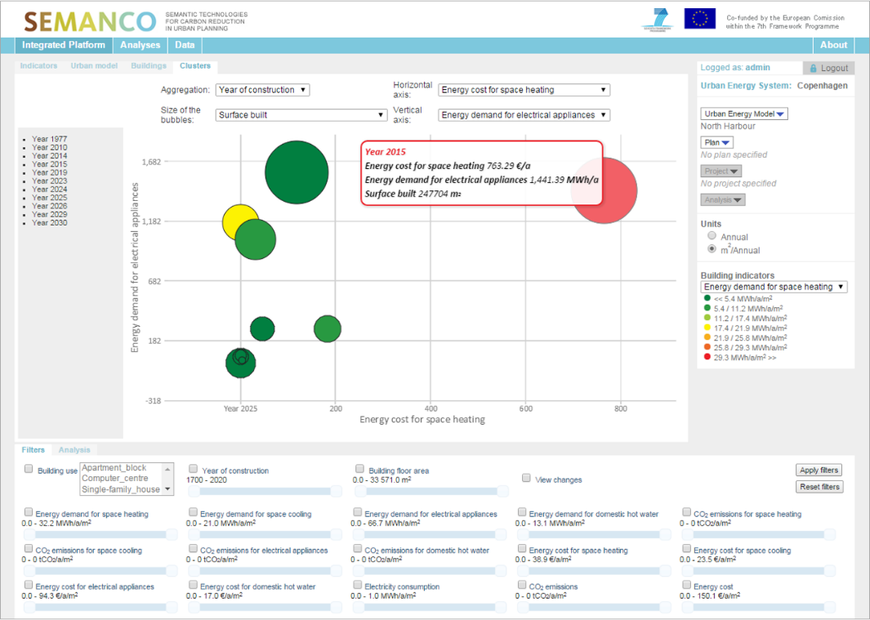
MULTIPLE SCALE VISUALIZATION
PERFORMANCE INDICATORS FILTERING
TABLE VIEW
CLUSTER VIEW

Slide 6
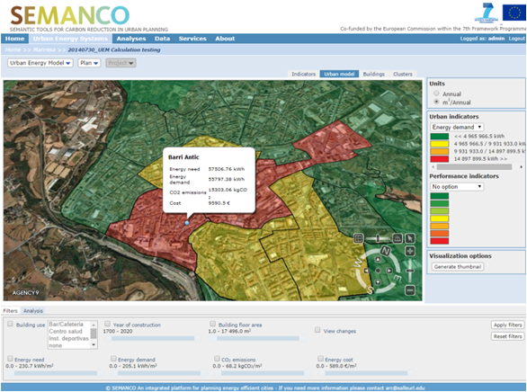
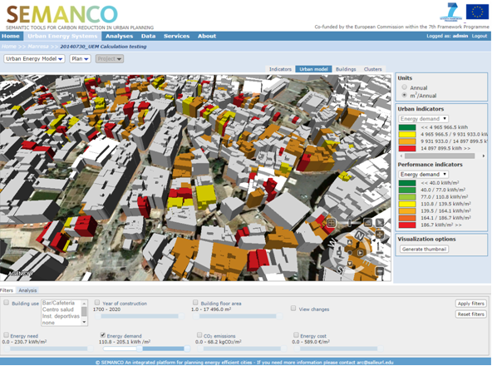
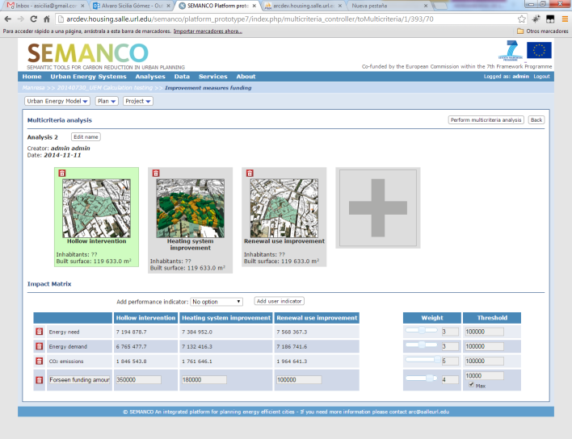
Manresa, SPAIN
Purpose: Assessment of the effectiveness of the measures to refurbish buildings in two neighbourhoods.
Users: Architect, Industrial Engineer, Engineer, Urban Planner
Data sources: Cadastre, census, socio-economic, building typologies (u-values, windows properties, systems…)
Tools: URSOS simulation engine
Projects:
Building envelope: upgrading windows
Heating system improvement: acquiring new high efficient boilers
Use of renewable energies: installing energy generation systems fed with renewable sources.

Slide 7
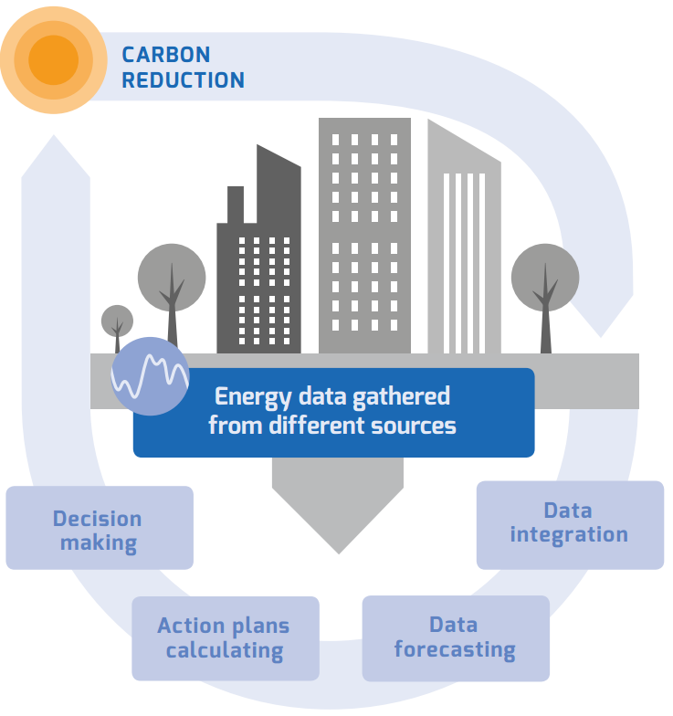
Optimising energy use in cities through a smart decision support system
The OPTIMUS DSS will be tested in three municipalities across Europe:
Savona, ITALY
Sant Cugat del Vallès, SPAIN
Zaanstad, THE NETHERLANDS

Slide 8
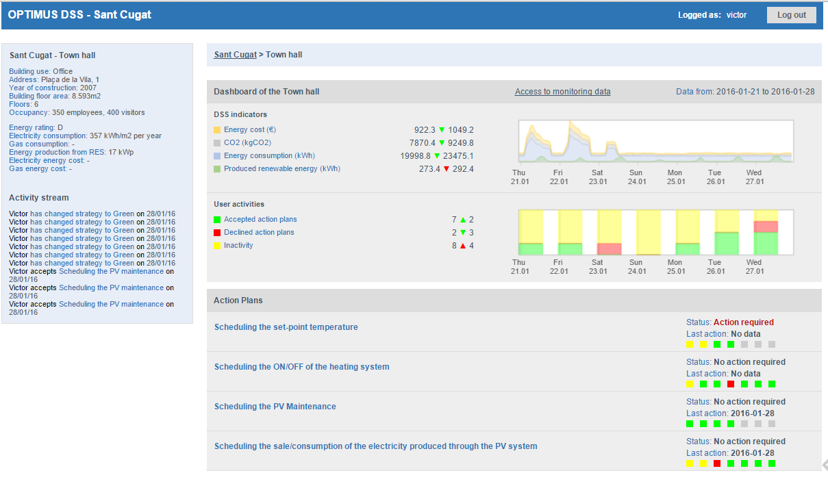
OPTIMUS DSS
Building dashboard

Slide 9
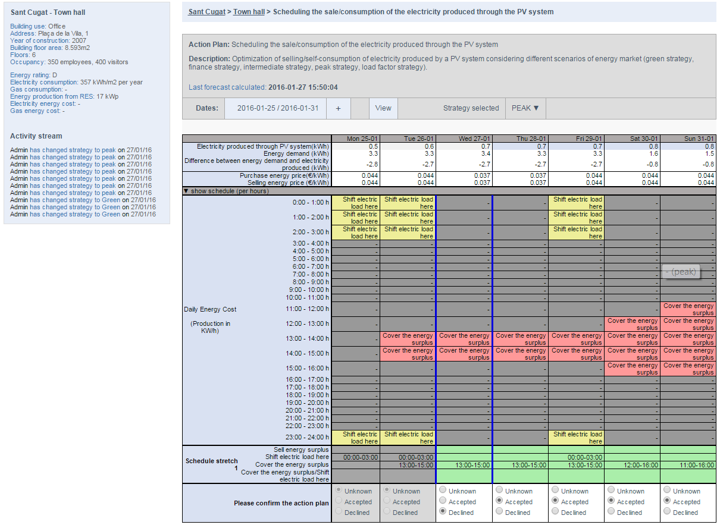
Optimization of selling/consumption of electricity produced by a PV system

